Slide 1
Predicting preferred accommodation for a personalized travel recommendation system

Slide 2
Purpose of this project
The task was to discover patterns in the traveler and trip features that predict the accommodation type for a trip. The dataset is from a travel agency and consist of 7 records: - Unique trip id - Duration of the trip (in days) - Gender of the booker - Age of the booker (in years) - Kids in travel party (true/false) - Destination country - Accommodation type(apartment/hotel)

Slide 3
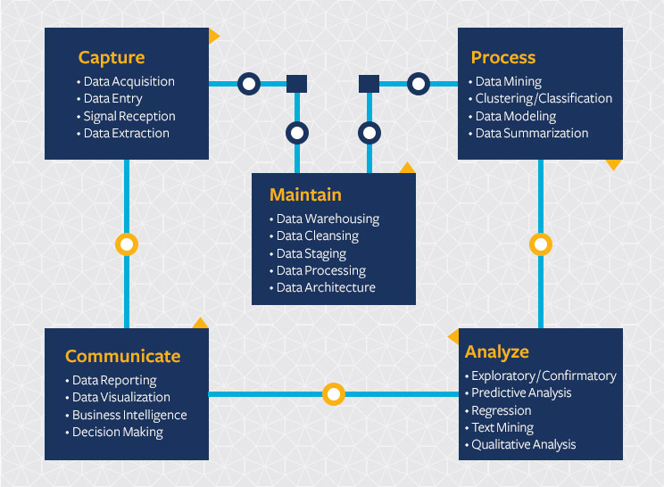
process flow

Slide 4
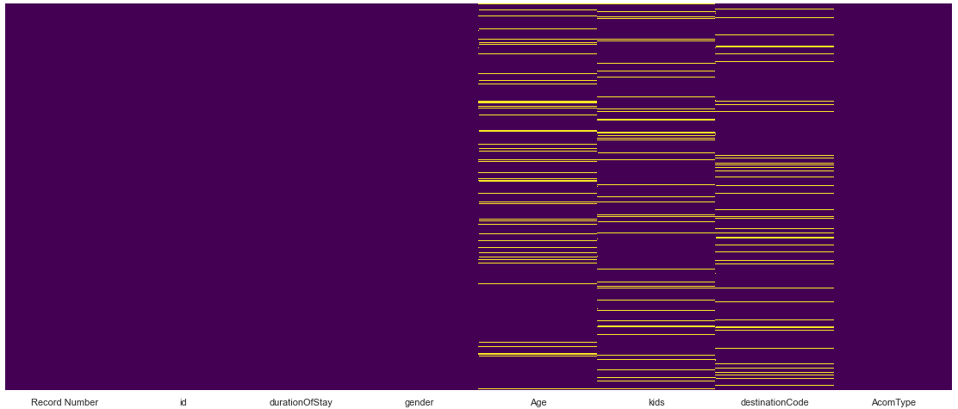
Missing values
Age:
10% missing values
Continuous variable
Median
Kids
9.8% missing values
Continuous variable
Median
DestinationCode
- 10% missing values
- Categorical value
- Mode used

Slide 5
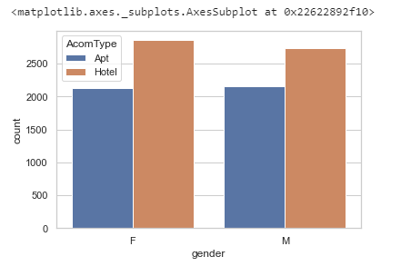
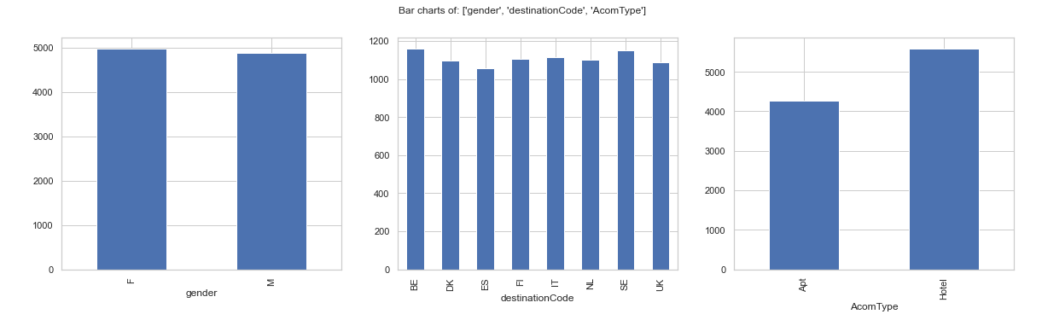
Exploratory Data Analysis
Female:
- Prefers Hotel accommodation type
Male:
- Prefers Hotel accommodation type
Most bookers are Female
BE and SE are the top 2 preferred destination type
Hotel is proffered over apt

Slide 6
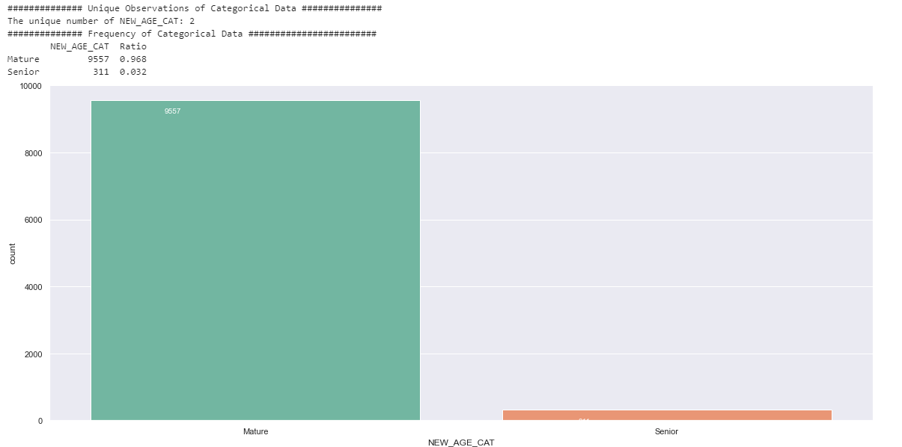
Exploratory Data Analysis
It is interesting to see that there are
- No young bookers
- Most of the bookers are Mature
- Small amount of Senior bookers
It could be interesting for them to see if they can expand their client base by focusing more on Senior and Junior Segment
Juniors and Seniors tend to have lesser money. For the Seniors they could come up with a certain Senior discount and for the Juniors regular discounts on accommodation

Slide 7
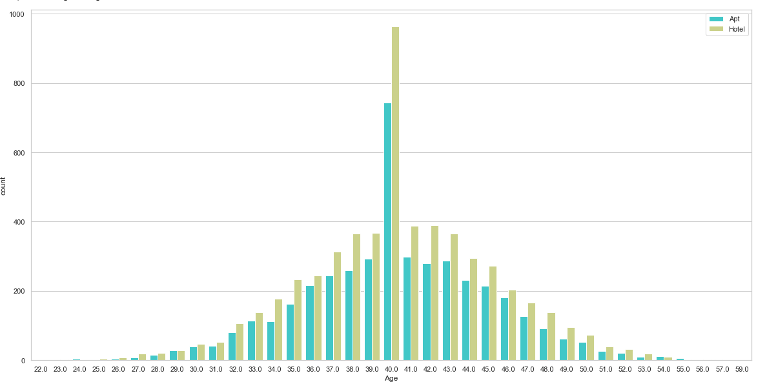
Exploratory Data Analysis
It is interesting to see as the age increases the choice for accommodation type Hotel also increases. This can be caused by several factors:
The older you get the less fit you might be to maintain an apartment
Younger people with younger kids are likely to travel more together and therefore an apartment is more convenient
Most of the distribution of Age is around 40. Which is their main focus point

Slide 8
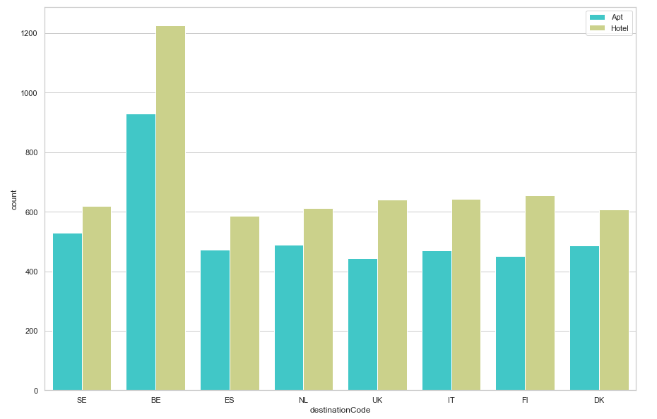
Exploratory Data Analysis
We can see that BE has the highest number of bookers. Perhaps to increase their customers base in the other countries. They can do a research why BE has higher bookers compared to the other countries and why Appartement is preferred over Hotel

Slide 9
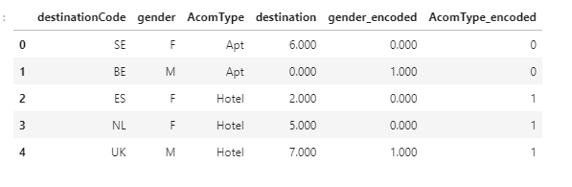
Data Preprocessing
The dataset consists of 3 categorical features and the Machine Learning model does not perform well on categorical data.
Therefore I have used for
destinationCode: OrdinalEncoder from sklearn library
Gender: OrdinalEncoder from sklearn library
AccomType: labelEconder from sklearn

Slide 10
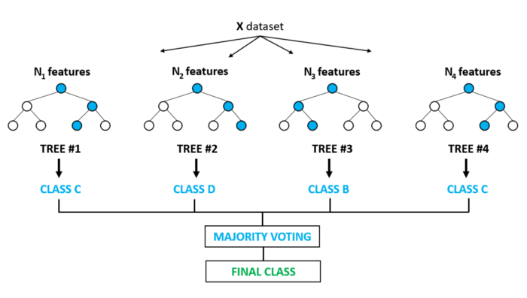
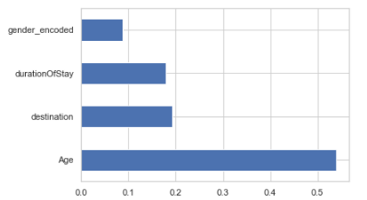
Model Random Forrest Classifier
Based on the problem statement I have chosen Random Forrest Classifier as the Machine Learning algorithm.
Random forest classifier creates a set of decision trees from randomly selected subset of training set. It then aggregates the votes from different decision trees to decide the final class of the object. (https://github.com/Prashantprojects/Decision-Tree/blob/main/Decision%20Trees%20Classifications.ipynb)
I was able to get a accuracy score of 85% on the Train data and 73% on the test data which means our model is performing well and is not overfitting.
I have used features durationofStay, age, kids, destination and gender_encoded for Random Forrest Classifier to learn on. Feature Age has a high importance in prediction the accommodation type

Slide 11
Improvements
Hyper parameter tuning with cross validation can be done to increase the accuracy of the model.
K-nearest neighbor could be used to treat missing values. Would be interesting to see if that increases the accuracy of the model.
Test other tree based algorithms such as AdaBoost, Gradient Boosting, XGB and Light GBM
Would be cool to see how you guys solve these kind of problem statement

Slide 12
Questions?

